Slide 1
Physics 6B
Waves and Sound Examples
Prepared by Vince Zaccone
For Campus Learning Assistance Services at UCSB

Slide 2
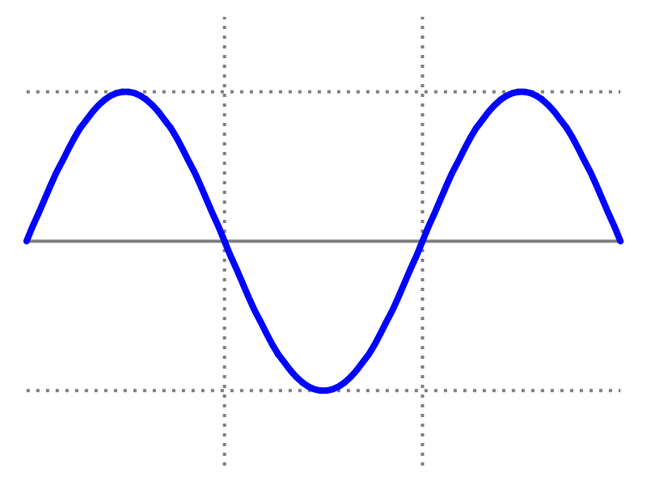
Wave Basics – This is a transverse* wave.
The WAVELENGTH (λ) is the distance between successive wave peaks.
The PERIOD (T) is the time it takes for the wave to move one wavelength.
The FREQUENCY (f) is the reciprocal of the period. f=1/T or T=1/f
The main formula for all waves relates these quantities to the wave speed:
v = λ•f = λ/T
Wavelength (λ)
Wave is propagating to the right at speed v
Amplitude (A)
*Transverse means the wave propagates perpendicular to the displacement of the underlying medium (like waves on water or a string).
Prepared by Vince Zaccone
For Campus Learning Assistance Services at UCSB

Slide 3
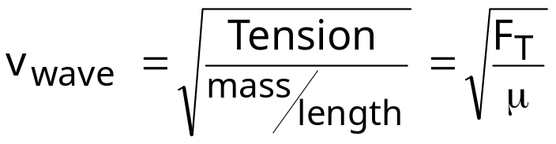
Wave Speeds
Speed depends on mechanical properties of the medium (i.e. density or tension, etc.)
All waves in the same medium will travel the same speed*.
When a wave propagates from one medium to another, its speed and wavelength will change, but its frequency will be constant.
For the specific case of a wave on a string, we have a formula for speed:
*We will see one exception to this later, when we deal with light (Ch. 23).
Prepared by Vince Zaccone
For Campus Learning Assistance Services at UCSB

Slide 4
EXAMPLE With what tension must a rope with length 2.5m and mass 0.12 kg be stretched for transverse waves of frequency 40.0Hz to have a wavelength of 0.75m?
Prepared by Vince Zaccone
For Campus Learning Assistance Services at UCSB

Slide 5
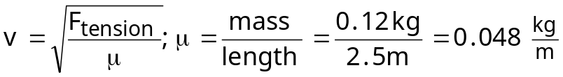
EXAMPLE With what tension must a rope with length 2.5m and mass 0.12 kg be stretched for transverse waves of frequency 40.0Hz to have a wavelength of 0.75m?
Prepared by Vince Zaccone
For Campus Learning Assistance Services at UCSB

Slide 6

EXAMPLE With what tension must a rope with length 2.5m and mass 0.12 kg be stretched for transverse waves of frequency 40.0Hz to have a wavelength of 0.75m?
To use this we need to find the wave speed. Luckily we have a formula for that:
Prepared by Vince Zaccone
For Campus Learning Assistance Services at UCSB

Slide 7

EXAMPLE With what tension must a rope with length 2.5m and mass 0.12 kg be stretched for transverse waves of frequency 40.0Hz to have a wavelength of 0.75m?
To use this we need to find the wave speed. Luckily we have a formula for that:
Prepared by Vince Zaccone
For Campus Learning Assistance Services at UCSB

Slide 8
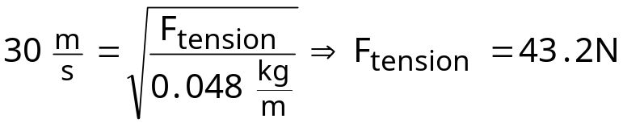
EXAMPLE With what tension must a rope with length 2.5m and mass 0.12 kg be stretched for transverse waves of frequency 40.0Hz to have a wavelength of 0.75m?
To use this we need to find the wave speed. Luckily we have a formula for that:
Now plug into the previous equation:
Prepared by Vince Zaccone
For Campus Learning Assistance Services at UCSB

Slide 9
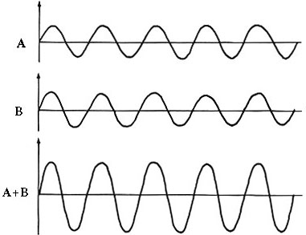
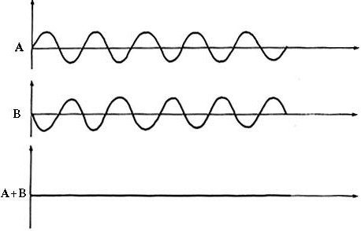
Constructive Interference:
Waves add - larger amplitude.
These waves are “In Phase”
Destructive Interference:
Waves cancel - smaller amplitude.
These waves are “Out of Phase”
They are out of sync by ½λ
Interference in action:
http://www.kettering.edu/physics/drussell/Demos/superposition/superposition.html
Prepared by Vince Zaccone
For Campus Learning Assistance Services at UCSB

Slide 10
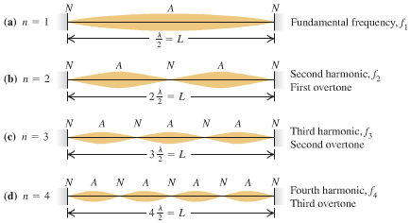
Standing Waves
When waves are traveling back and forth along the string, they interfere to form standing waves. These are the only waveforms that will “fit” on the string. Notice that this pattern gives us our formulas.
Prepared by Vince Zaccone
For Campus Learning Assistance Services at UCSB

Slide 11
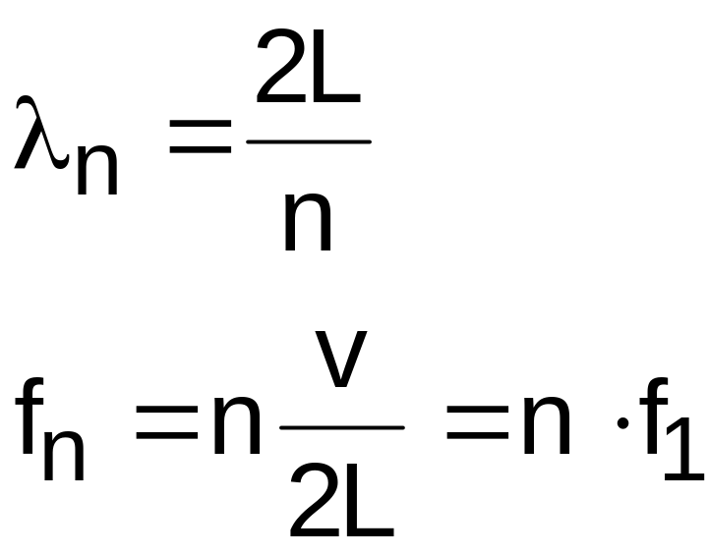
Standing Waves
Basic formulas for waves on a string:
Prepared by Vince Zaccone
For Campus Learning Assistance Services at UCSB

Slide 12
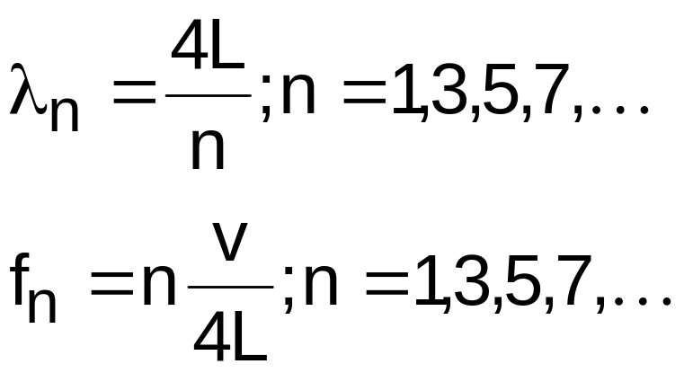
Standing Waves
Basic formulas for waves on a string:
For waves in a pipe:
Both ends open – same as the string
One end closed – modified formulas
Prepared by Vince Zaccone
For Campus Learning Assistance Services at UCSB

Slide 13
EXAMPLE A wire with mass 40g is stretched so that its ends are tied down at points 80cm apart. The wire vibrates in its fundamental mode with frequency 60Hz. a) What is the speed of propagation of transverse waves in the wire? b) Compute the tension in the wire. c) What is the frequency and wavelength of the 4th harmonic?
Prepared by Vince Zaccone
For Campus Learning Assistance Services at UCSB

Slide 14
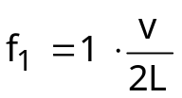

EXAMPLE A wire with mass 40g is stretched so that its ends are tied down at points 80cm apart. The wire vibrates in its fundamental mode with frequency 60Hz.
a) What is the speed of propagation of transverse waves in the wire?
b) Compute the tension in the wire.
c) What is the frequency and wavelength of the 4th harmonic?
Since the string is in its fundamental mode (1st harmonic) we have a formula for frequency:
Prepared by Vince Zaccone
For Campus Learning Assistance Services at UCSB

Slide 15

EXAMPLE A wire with mass 40g is stretched so that its ends are tied down at points 80cm apart. The wire vibrates in its fundamental mode with frequency 60Hz.
a) What is the speed of propagation of transverse waves in the wire?
b) Compute the tension in the wire.
c) What is the frequency and wavelength of the 4th harmonic?
Since the string is in its fundamental mode (1st harmonic) we have a formula for frequency:
Solve this for v:
Prepared by Vince Zaccone
For Campus Learning Assistance Services at UCSB

Slide 16
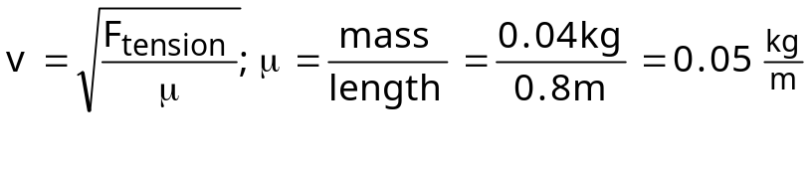
EXAMPLE A wire with mass 40g is stretched so that its ends are tied down at points 80cm apart. The wire vibrates in its fundamental mode with frequency 60Hz.
a) What is the speed of propagation of transverse waves in the wire?
b) Compute the tension in the wire.
c) What is the frequency and wavelength of the 4th harmonic?
Since the string is in its fundamental mode (1st harmonic) we have a formula for frequency:
Solve this for v:
Now we can use our formula for wave speed to find the tension:
Prepared by Vince Zaccone
For Campus Learning Assistance Services at UCSB

Slide 17
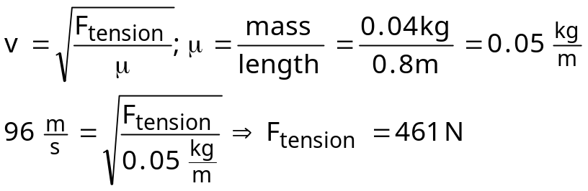
EXAMPLE A wire with mass 40g is stretched so that its ends are tied down at points 80cm apart. The wire vibrates in its fundamental mode with frequency 60Hz.
a) What is the speed of propagation of transverse waves in the wire?
b) Compute the tension in the wire.
c) What is the frequency and wavelength of the 4th harmonic?
Since the string is in its fundamental mode (1st harmonic) we have a formula for frequency:
Solve this for v:
Now we can use our formula for wave speed to find the tension:
Prepared by Vince Zaccone
For Campus Learning Assistance Services at UCSB

Slide 18
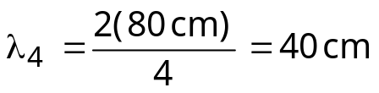

EXAMPLE A wire with mass 40g is stretched so that its ends are tied down at points 80cm apart. The wire vibrates in its fundamental mode with frequency 60Hz.
a) What is the speed of propagation of transverse waves in the wire?
b) Compute the tension in the wire.
c) What is the frequency and wavelength of the 4th harmonic?
Since the string is in its fundamental mode (1st harmonic) we have a formula for frequency:
Solve this for v:
Now we can use our formula for wave speed to find the tension:
To get the 4th harmonic frequency, just multiply the 1st harmonic by 4
To get the 4th harmonic wavelength, just divide the 1st harmonic by 4
Prepared by Vince Zaccone
For Campus Learning Assistance Services at UCSB

Slide 19
Example: Suppose we have 2 strings. String B has twice the mass density of string A (B is thicker and heavier). If both wires have the same tension applied to them, how can we adjust their lengths so that their fundamental frequencies are equal?
Prepared by Vince Zaccone
For Campus Learning Assistance Services at UCSB

Slide 20
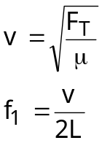
Example: Suppose we have 2 strings. String B has twice the mass density of string A (B is thicker and heavier). If both wires have the same tension applied to them, how can we adjust their lengths so that their fundamental frequencies are equal?
The relevant formulas are:
Speed of wave on string
Fundamental frequency
Prepared by Vince Zaccone
For Campus Learning Assistance Services at UCSB

Slide 21

Example: Suppose we have 2 strings. String B has twice the mass density of string A (B is thicker and heavier). If both wires have the same tension applied to them, how can we adjust their lengths so that their fundamental frequencies are equal?
The relevant formulas are:
Speed of wave on string
Fundamental frequency
We need the fundamental frequencies to be equal:
Prepared by Vince Zaccone
For Campus Learning Assistance Services at UCSB

Slide 22

Example: Suppose we have 2 strings. String B has twice the mass density of string A (B is thicker and heavier). If both wires have the same tension applied to them, how can we adjust their lengths so that their fundamental frequencies are equal?
The relevant formulas are:
Speed of wave on string
Fundamental frequency
We need the fundamental frequencies to be equal:
Rearranging this equation:
Prepared by Vince Zaccone
For Campus Learning Assistance Services at UCSB

Slide 23
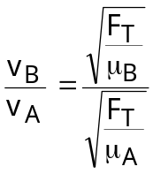
Example: Suppose we have 2 strings. String B has twice the mass density of string A (B is thicker and heavier). If both wires have the same tension applied to them, how can we adjust their lengths so that their fundamental frequencies are equal?
The relevant formulas are:
Speed of wave on string
Fundamental frequency
We need the fundamental frequencies to be equal:
Rearranging this equation:
Now we can use the formula for wave speed:
Prepared by Vince Zaccone
For Campus Learning Assistance Services at UCSB

Slide 24
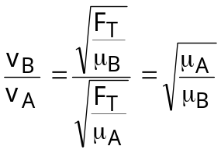
Example: Suppose we have 2 strings. String B has twice the mass density of string A (B is thicker and heavier). If both wires have the same tension applied to them, how can we adjust their lengths so that their fundamental frequencies are equal?
The relevant formulas are:
Speed of wave on string
Fundamental frequency
We need the fundamental frequencies to be equal:
Rearranging this equation:
Now we can use the formula for wave speed:
Prepared by Vince Zaccone
For Campus Learning Assistance Services at UCSB

Slide 25
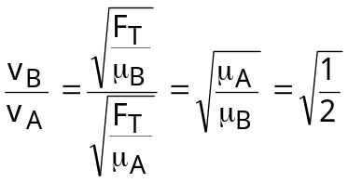
Example: Suppose we have 2 strings. String B has twice the mass density of string A (B is thicker and heavier). If both wires have the same tension applied to them, how can we adjust their lengths so that their fundamental frequencies are equal?
The relevant formulas are:
Speed of wave on string
Fundamental frequency
We need the fundamental frequencies to be equal:
Rearranging this equation:
Now we can use the formula for wave speed:
Prepared by Vince Zaccone
For Campus Learning Assistance Services at UCSB

Slide 26

Example: Suppose we have 2 strings. String B has twice the mass density of string A (B is thicker and heavier). If both wires have the same tension applied to them, how can we adjust their lengths so that their fundamental frequencies are equal?
The relevant formulas are:
Speed of wave on string
Fundamental frequency
We need the fundamental frequencies to be equal:
Rearranging this equation:
Now we can use the formula for wave speed:
Finally we can plug this into our previous equation:
Prepared by Vince Zaccone
For Campus Learning Assistance Services at UCSB

Slide 27
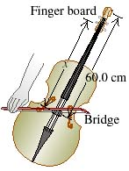
EXAMPLE The portion of string between the bridge and upper end of the fingerboard (the part of the string that is free to vibrate) of a certain musical instrument is 60.0 cm long and has a mass of 2.81g . The string sounds an A₄ note (440 Hz) when played.
●Where must the player put a finger( at what distance x from the bridge) to play a D₅ note (587 Hz)? For both notes, the string vibrates in its fundamental mode.
Prepared by Vince Zaccone
For Campus Learning Assistance Services at UCSB

Slide 28
EXAMPLE The portion of string between the bridge and upper end of the fingerboard (the part of the string that is free to vibrate) of a certain musical instrument is 60.0 cm long and has a mass of 2.81g . The string sounds an A₄ note (440 Hz) when played.
●Where must the player put a finger( at what distance x from the bridge) to play a D₅ note (587 Hz)? For both notes, the string vibrates in its fundamental mode.
When a string is vibrating in its fundamental mode (i.e. 1st harmonic), its wavelength is given by λ=2L. In this case λ=1.20m.
Prepared by Vince Zaccone
For Campus Learning Assistance Services at UCSB

Slide 29
EXAMPLE The portion of string between the bridge and upper end of the fingerboard (the part of the string that is free to vibrate) of a certain musical instrument is 60.0 cm long and has a mass of 2.81g . The string sounds an A₄ note (440 Hz) when played.
●Where must the player put a finger( at what distance x from the bridge) to play a D₅ note (587 Hz)? For both notes, the string vibrates in its fundamental mode.
When a string is vibrating in its fundamental mode (i.e. 1st harmonic), its wavelength is given by λ=2L. In this case λ=1.20m.
Now we can use our basic relationship for waves: v=f λ
This gives the speed of the waves on this string: v=528 m/s
Prepared by Vince Zaccone
For Campus Learning Assistance Services at UCSB

Slide 30
EXAMPLE The portion of string between the bridge and upper end of the fingerboard (the part of the string that is free to vibrate) of a certain musical instrument is 60.0 cm long and has a mass of 2.81g . The string sounds an A₄ note (440 Hz) when played.
●Where must the player put a finger( at what distance x from the bridge) to play a D₅ note (587 Hz)? For both notes, the string vibrates in its fundamental mode.
When a string is vibrating in its fundamental mode (i.e. 1st harmonic), its wavelength is given by λ=2L. In this case λ=1.20m.
Now we can use our basic relationship for waves: v=f λ
This gives the speed of the waves on this string: v=528 m/s
Now we work with the second case, where the finger is placed at a distance x away from the bridge. The wavelength in this case will be λ=2x.
Prepared by Vince Zaccone
For Campus Learning Assistance Services at UCSB

Slide 31

EXAMPLE The portion of string between the bridge and upper end of the fingerboard (the part of the string that is free to vibrate) of a certain musical instrument is 60.0 cm long and has a mass of 2.81g . The string sounds an A₄ note (440 Hz) when played.
●Where must the player put a finger( at what distance x from the bridge) to play a D₅ note (587 Hz)? For both notes, the string vibrates in its fundamental mode.
When a string is vibrating in its fundamental mode (i.e. 1st harmonic), its wavelength is given by λ=2L. In this case λ=1.20m.
Now we can use our basic relationship for waves: v=f λ
This gives the speed of the waves on this string: v=528 m/s
Now we work with the second case, where the finger is placed at a distance x away from the bridge. The wavelength in this case will be λ=2x.
Same string – same speed. Substitute into our basic formula to get:
Prepared by Vince Zaccone
For Campus Learning Assistance Services at UCSB

Slide 32
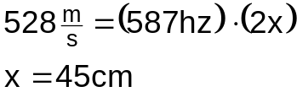
EXAMPLE The portion of string between the bridge and upper end of the fingerboard (the part of the string that is free to vibrate) of a certain musical instrument is 60.0 cm long and has a mass of 2.81g . The string sounds an A₄ note (440 Hz) when played.
●Where must the player put a finger( at what distance x from the bridge) to play a D₅ note (587 Hz)? For both notes, the string vibrates in its fundamental mode.
When a string is vibrating in its fundamental mode (i.e. 1st harmonic), its wavelength is given by λ=2L. In this case λ=1.20m.
Now we can use our basic relationship for waves: v=f λ
This gives the speed of the waves on this string: v=528 m/s
Now we work with the second case, where the finger is placed at a distance x away from the bridge. The wavelength in this case will be λ=2x.
Same string – same speed. Substitute into our basic formula to get:
Prepared by Vince Zaccone
For Campus Learning Assistance Services at UCSB

